Slide 1
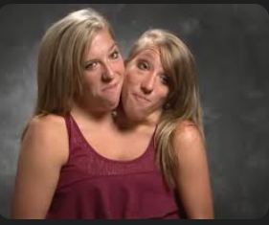
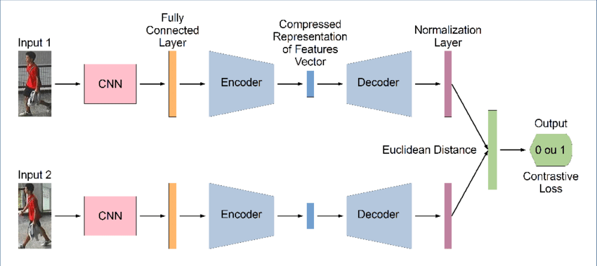
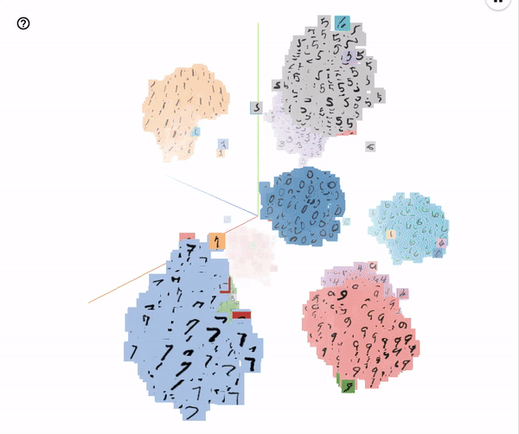
Siamese Network

Slide 2
Content
Image similarity models
Siamese Network for Image matching
Siamese network architecture
Tutorial 10: Implementation of Siamese network in Python
One-shot learning
Image pair creation
Metrics for Siamese network
Tutorial 11: Implementation of Siamese network in Python
Loss function for Siamese network
Siamese network for face recognition
Siamese network for small dataset
Tutorial 12: Case study on Siamese network

Slide 3
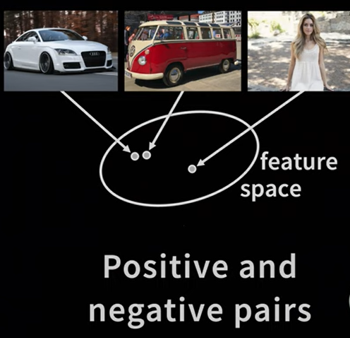
Image similarity models
Similar things are close different things are far
Image similarity models are machine learning models that assess how visually similar two or more images are.
They map images into a feature space and compute the distance between their feature representations to evaluate similarity.
The goal is to position similar images close together and dissimilar ones far apart in this feature space.

Slide 4
Applications:
Face Recognition: Matching faces across different photos or identifying the same person from various angles.
Image Retrieval: Finding images similar to a given query image from a database.
Object Matching: Detecting identical or similar objects in different scenes.
Visual Search: Providing visually similar results based on a user’s image input.

Slide 5
Model Types:
Siamese Networks:
Use a shared-weight architecture that processes pairs of images and outputs similarity scores.
Example: Comparing pairs of face images to determine if they belong to the same person.
Triplet Networks:
Utilize an anchor image, a positive (similar) image, and a negative (dissimilar) image to train a similarity function.
Example: Training with an anchor, a positive of the same class, and a negative of a different class to learn discriminative embeddings.
Convolutional Neural Networks (CNNs):
Extract features and then compute distances between feature vectors to determine similarity.
Example: A pre-trained CNN for feature extraction followed by cosine similarity to find similar images.
Vision Transformers (ViT):
Use transformer-based architectures for feature extraction and similarity computation.

Slide 6
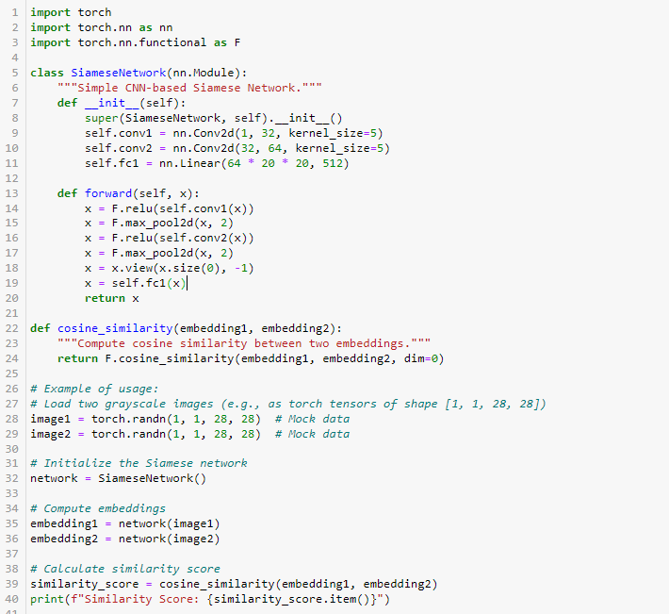

Slide 7
Few-Shot Learning
A short introduction to few-shot learning.
Few-shot learning means making classification or regression based on a very small number of samples.

Slide 8
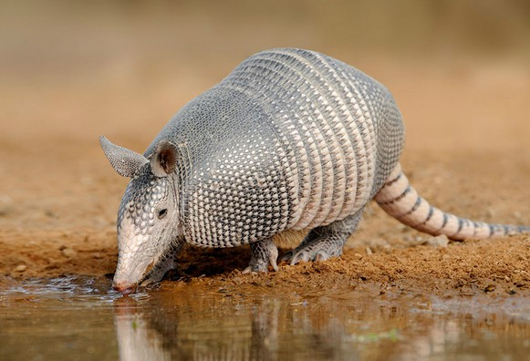
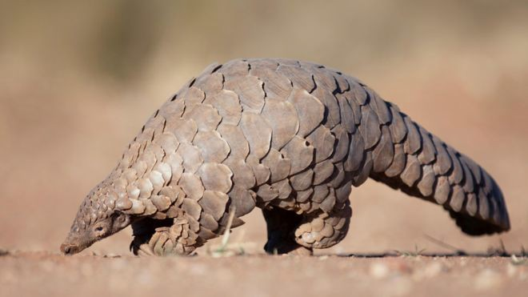
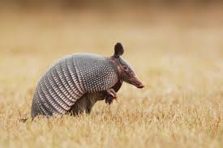
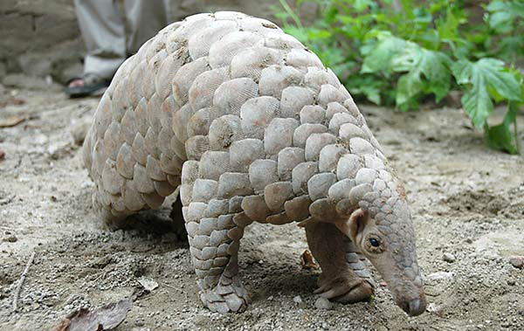
Support Set
Armadillo Pangolin
Pay attention to the differences and try to distinguish the two animals
Look at their ears and size or
scales.
Notes:
let's play a game.
I show you four images. Please look carefully.
The left two images are Armadillos. The right two are pangolins. You may have never heard of armadillo or pangolin, but it doesn't matter.
You just want to pay attention to the differences and try to distinguish the two animals. If
you don't know the difference, I can give you some hint. Look at their ears and size or
scales.

Slide 9
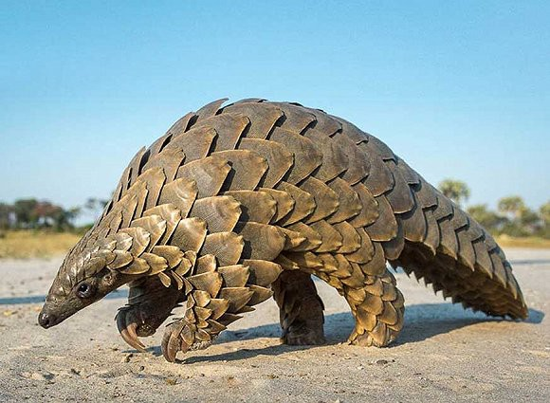
Support Set
Armadillo Pangolin
Query
Armadillo or Pangolin?
If a class has only two samples, can computer make the correct prediction? This is harder than the standard classification problem.
The number of samples is too small for training a deep neural network.

Slide 10
Terminology
Support Set: A small set of labeled examples (images, for instance) that represent the categories the model needs to distinguish. It is too small for training a model.
Query: An unlabeled sample that the model hasn't seen before and needs to classify or identify based on the knowledge it gained from the support set.
Few-Shot Learning is a problem of making predictions based on a limited number of samples. Few-Shot learning is different from the standard supervised learning.
The goal of Few-Shot learning is not to let the model recognize the images in the training set and then generalize to the test set. Instead, the goal is learn to learn.
Example in next slide

Slide 11
Goal of Few shot learning
Set of training Images of Animals
Model will learn similarity function
Image 1
Image 2
Train the model
Are they similar?
Train the model on a big training set.
The goal of training is not to know what elephant is and what tiger is.
The goal is not to be able to recognize unseen elephants and tigers.
Instead, the goal is to know the similarity and difference between objects.
After training, you can show the two images to the model and ask whether the two are the same kind of animals.
The model has learned the similarity and difference between objects.
So the model is able to tell that the content in the two images are the same kind of objects.

Slide 12
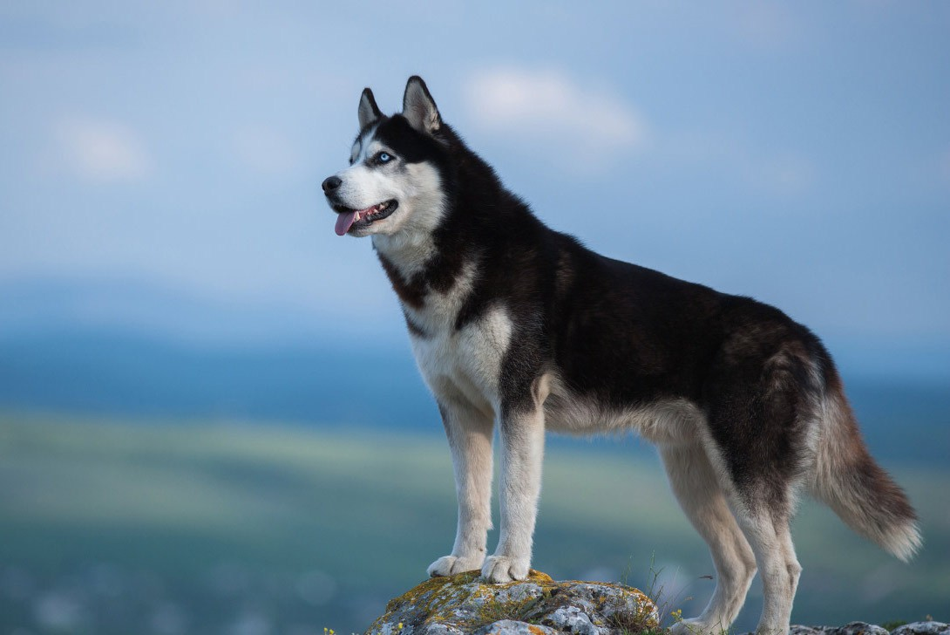
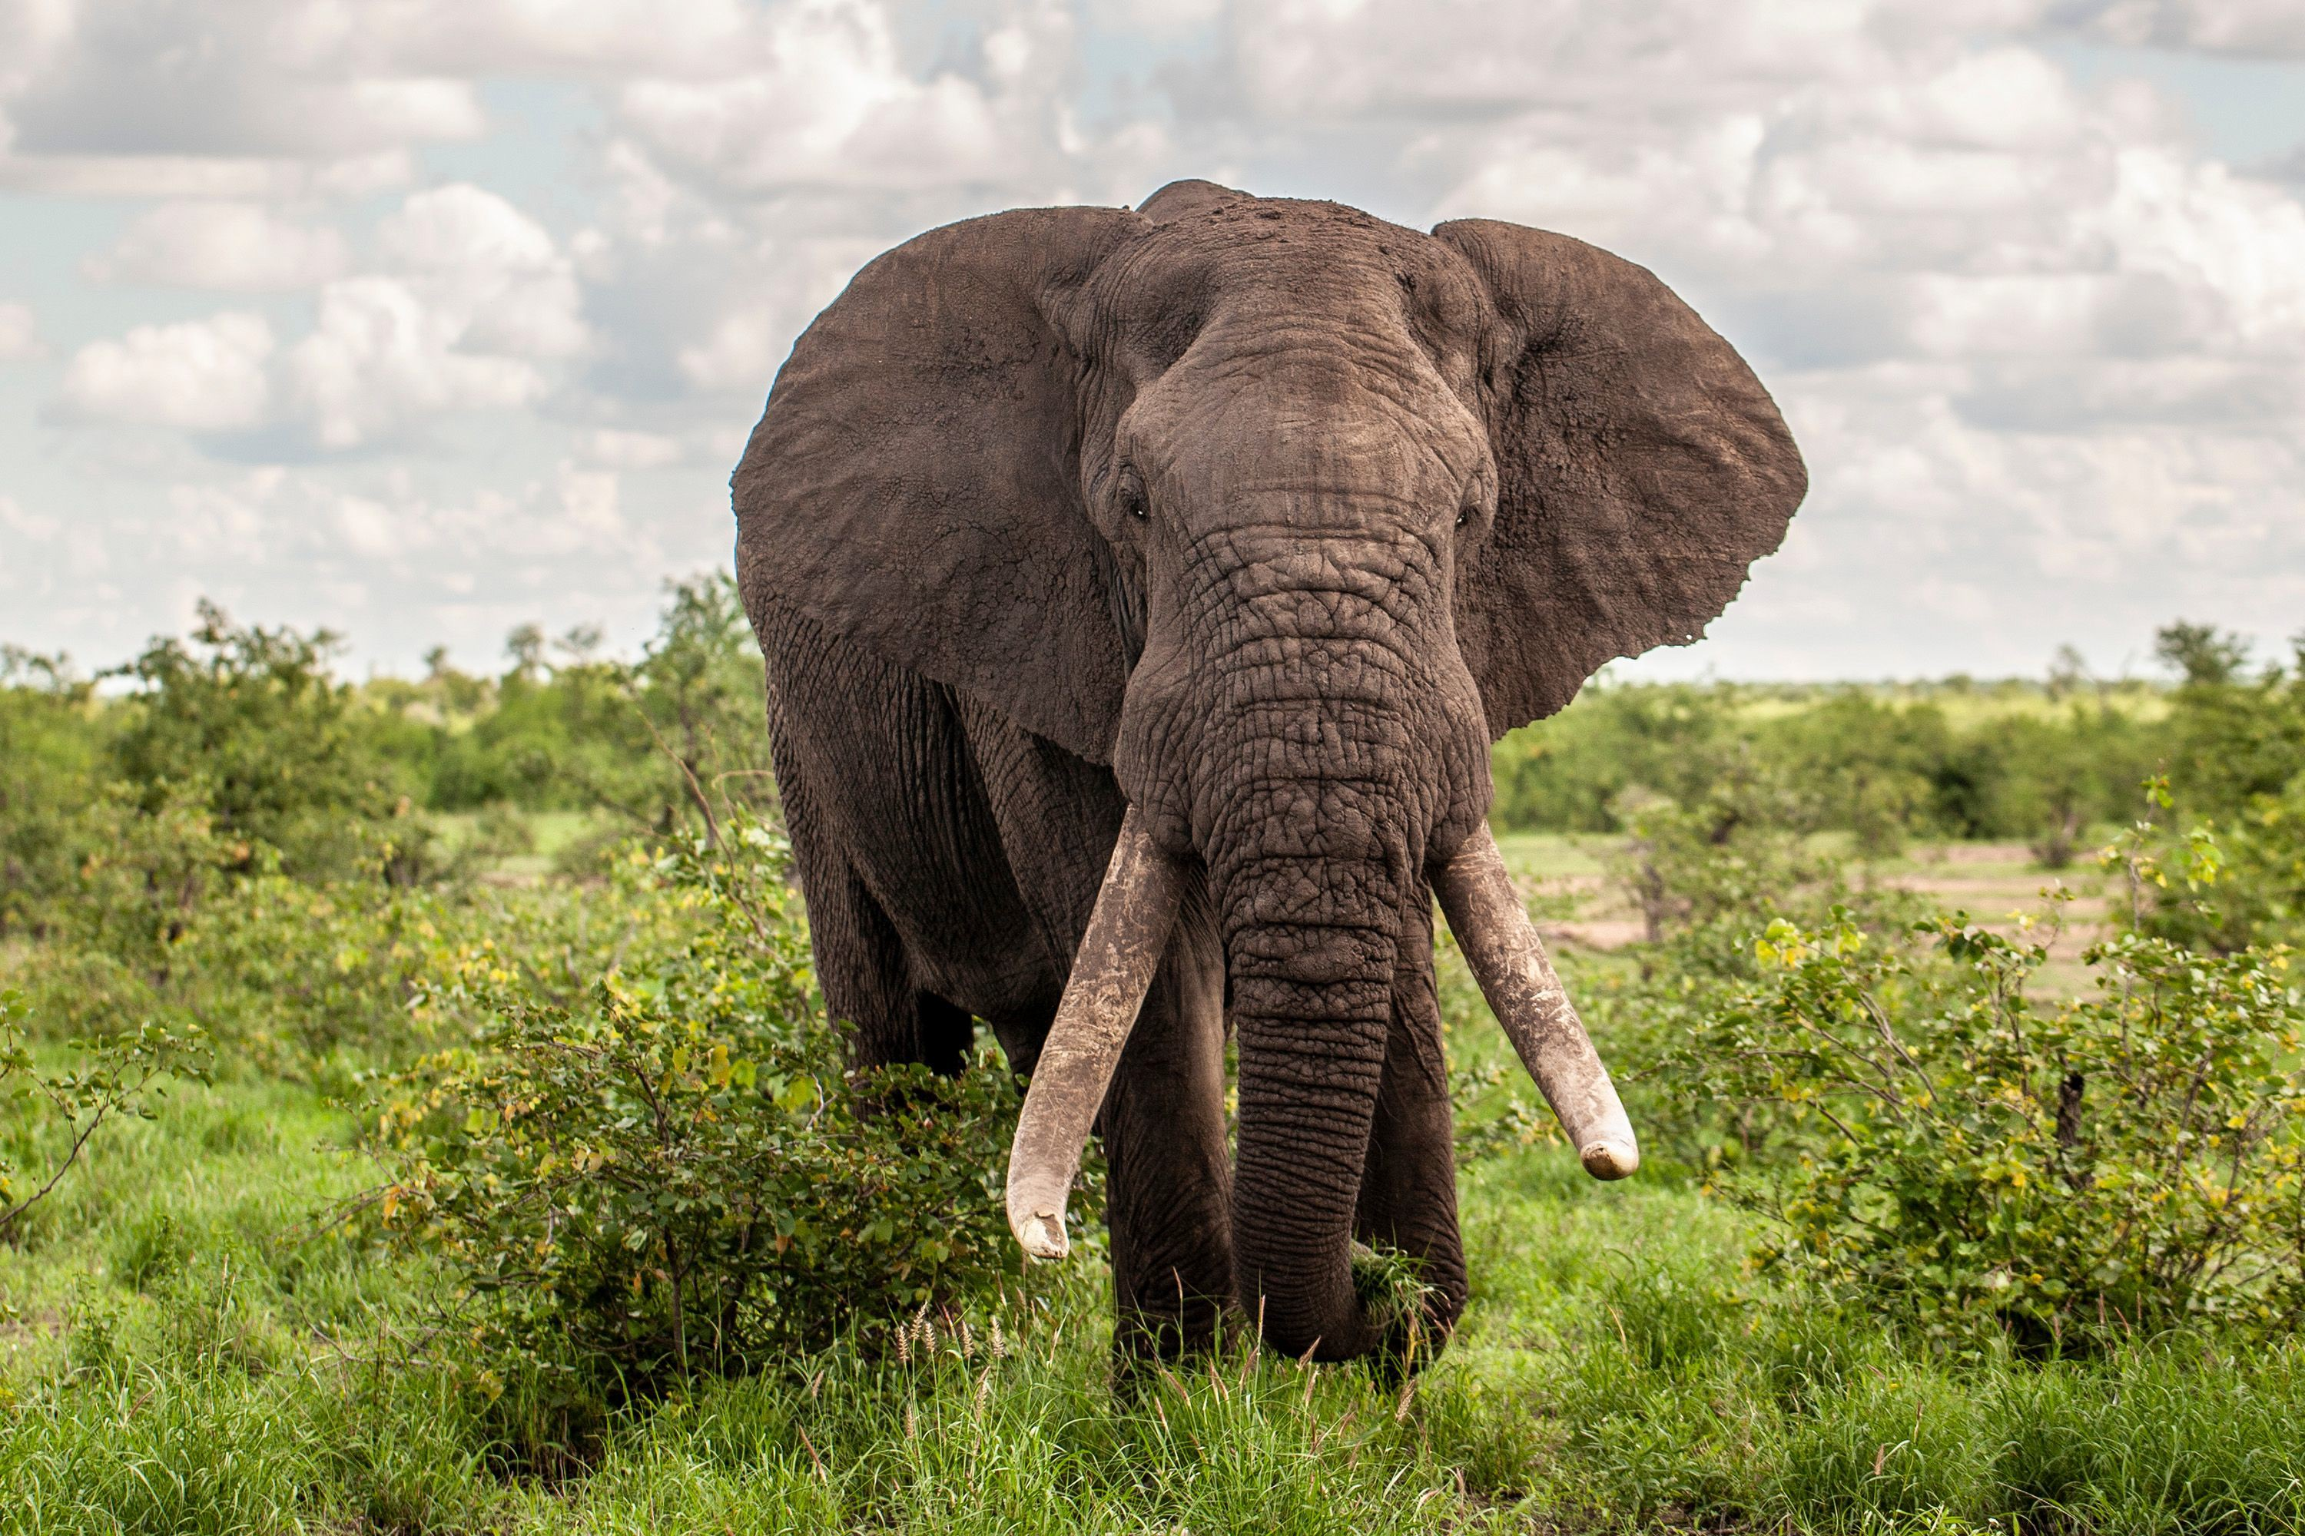
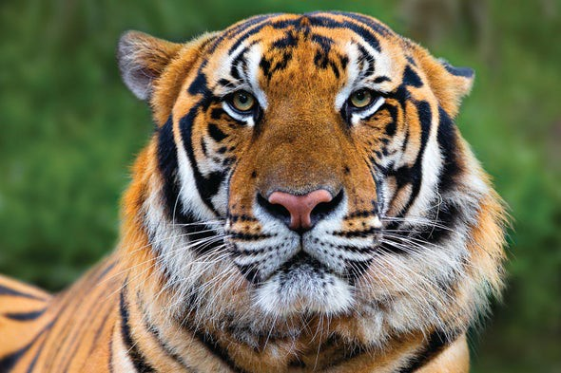
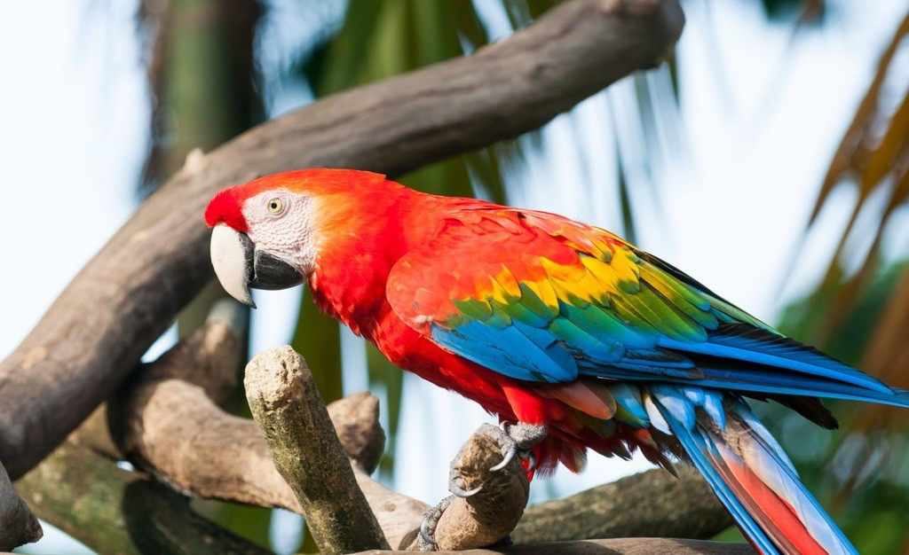
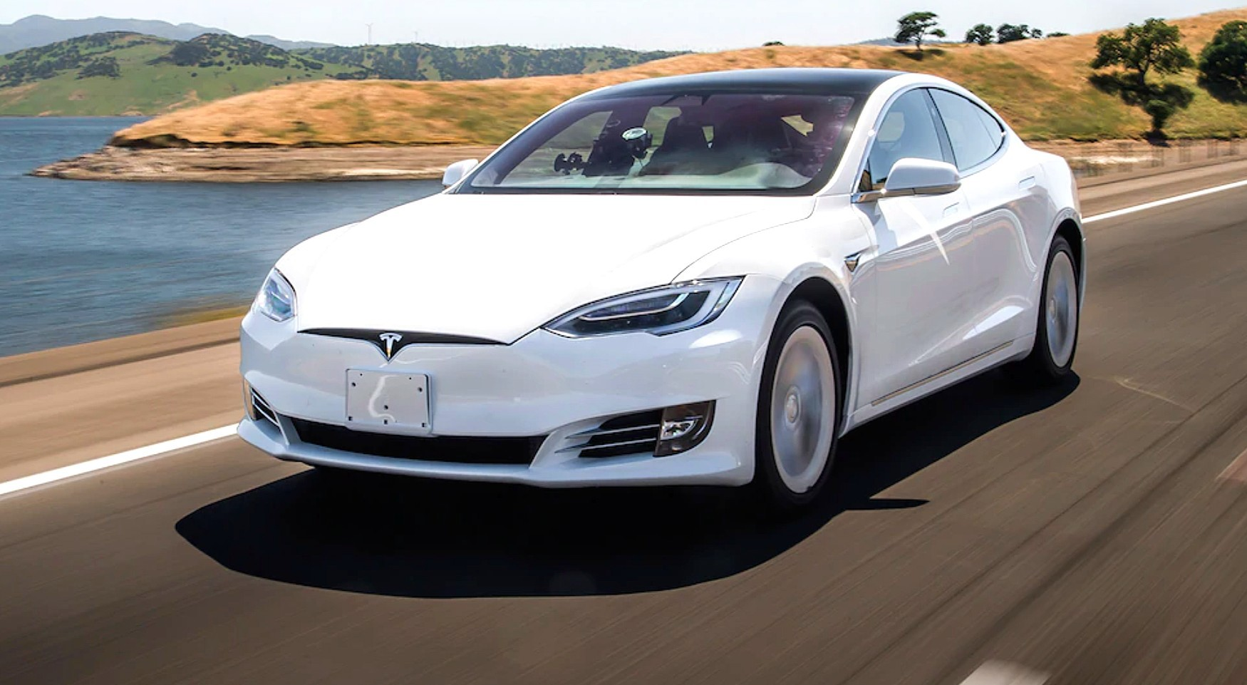
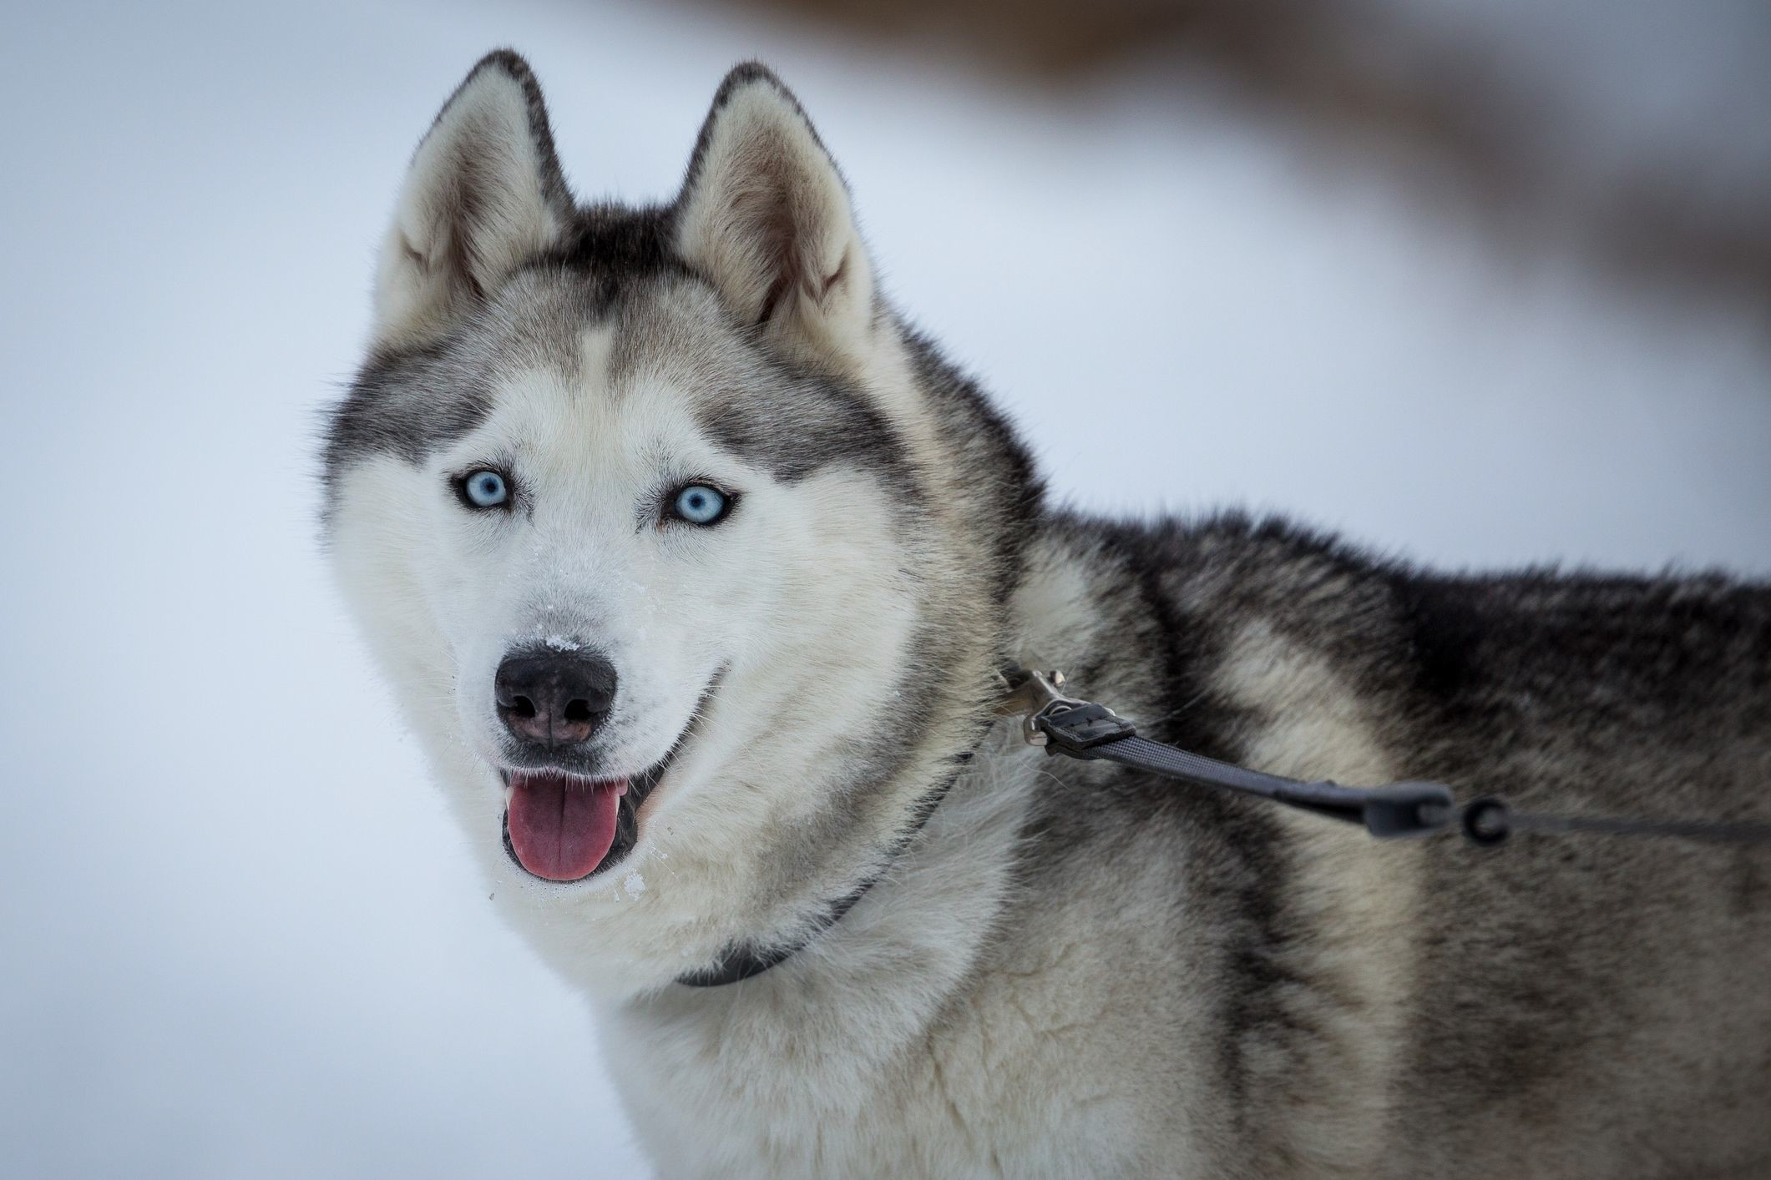
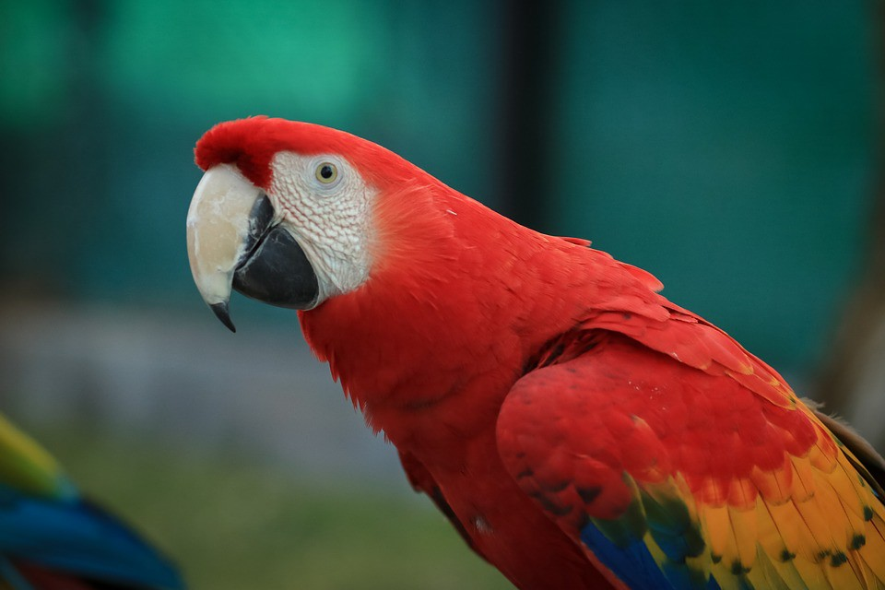
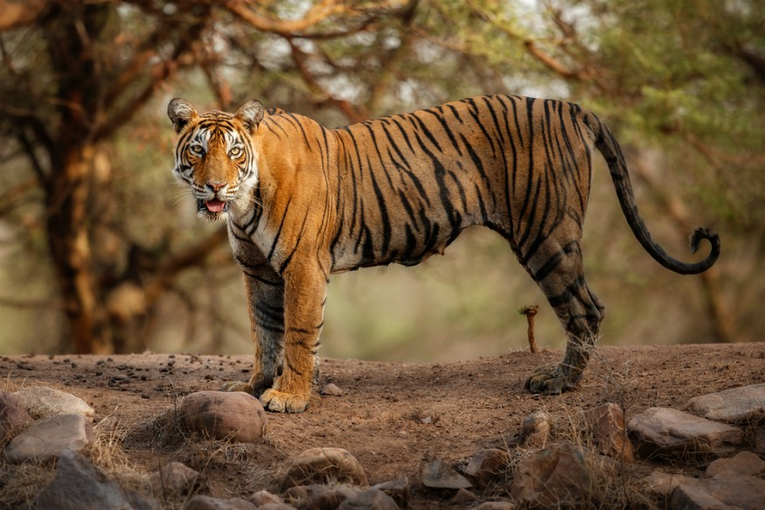
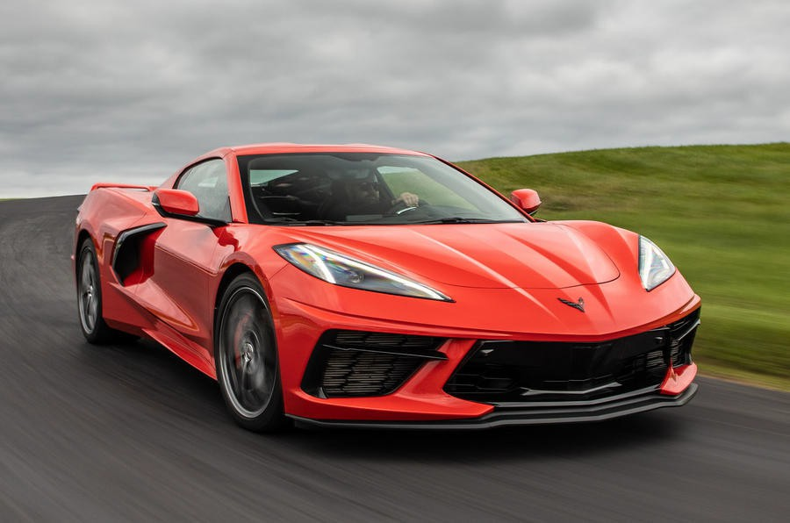
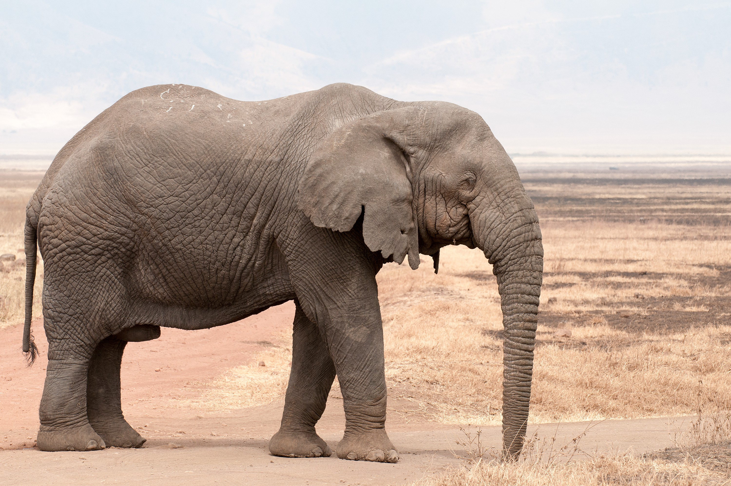
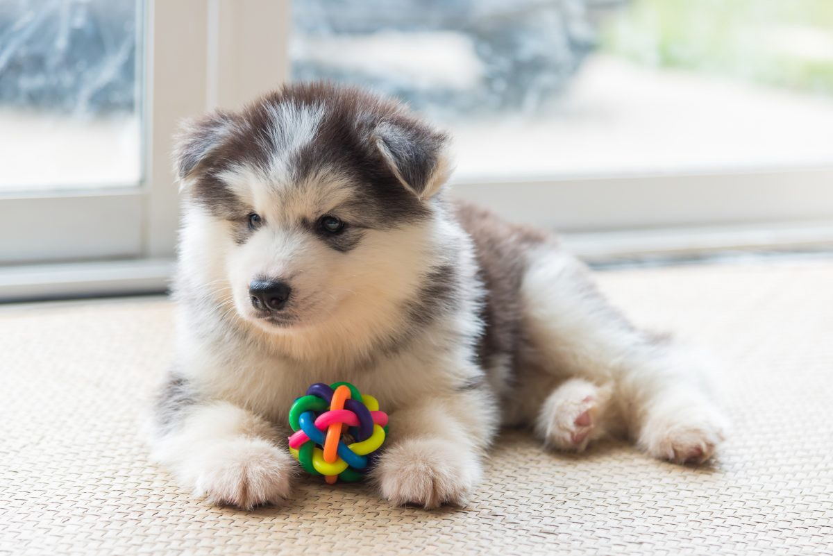
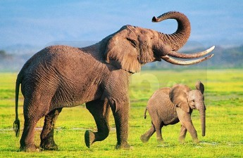
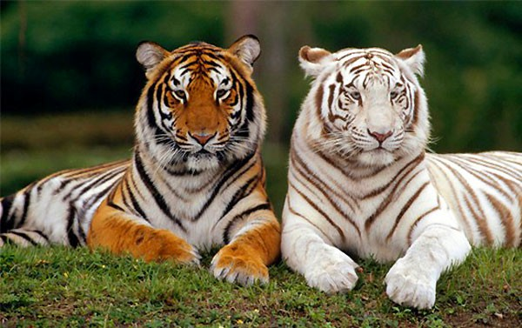
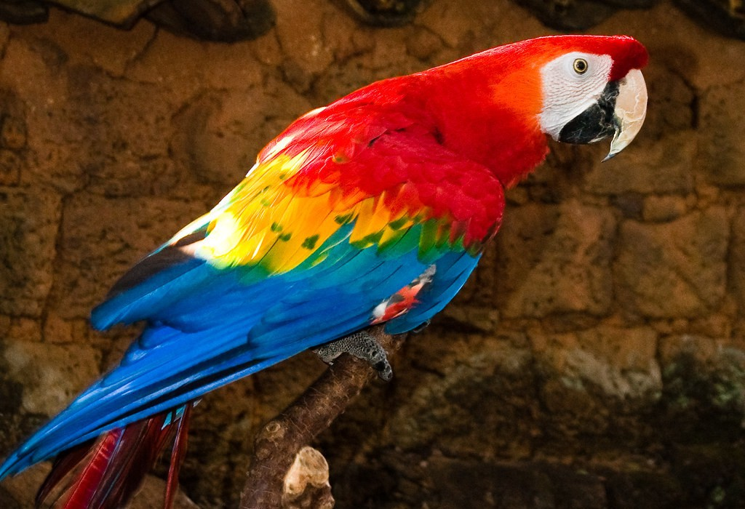
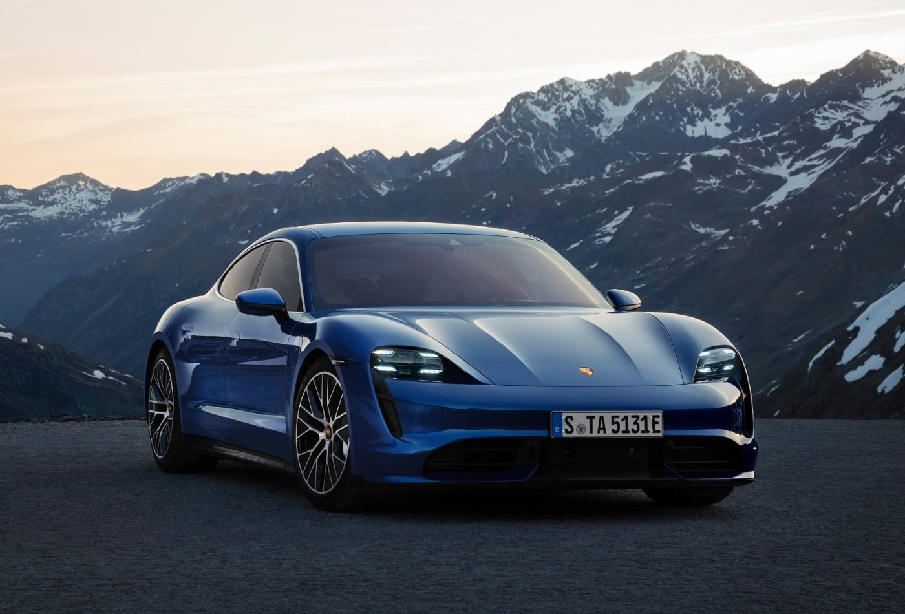
Training Set
Husky
Elephant
Tiger
Macaw
Car
⋮
⋮
⋮
⋮
⋮
The training data has five classes which do not include the squirrel class Thus, the model is unable to recognize squirrels.
If you show an image of a squirrel to the model, the model does not know it is a squirrel.

Slide 13
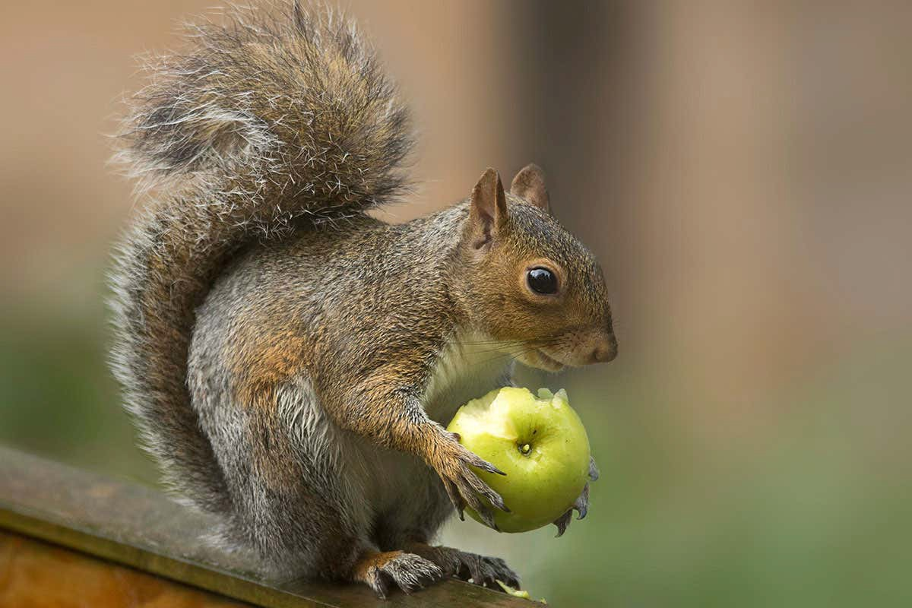
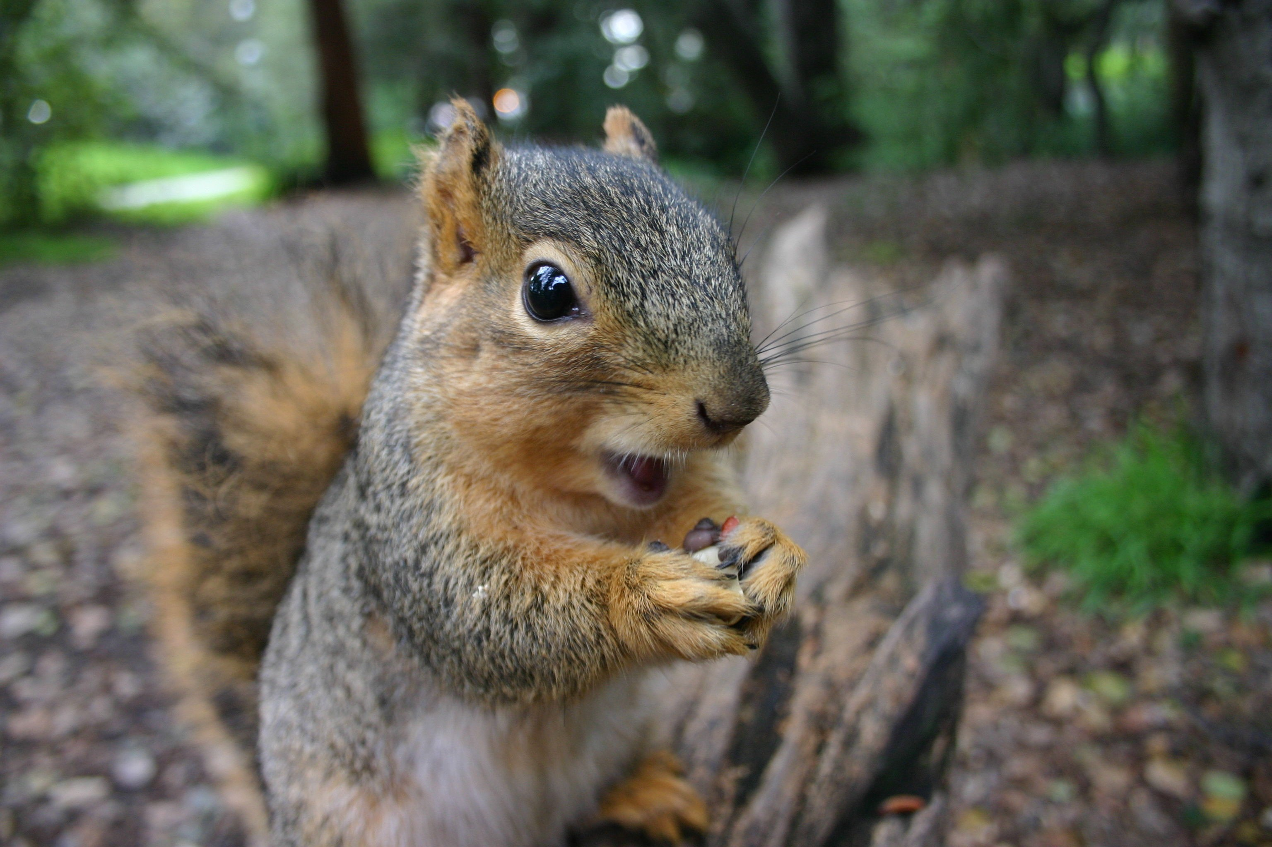
Are they the same kind of animal?
When the model sees two images, it does not know they are squirrels.
However, the model knows they look alike.
The model can tell you with high confidence that they are the same kind of objects.

Slide 14
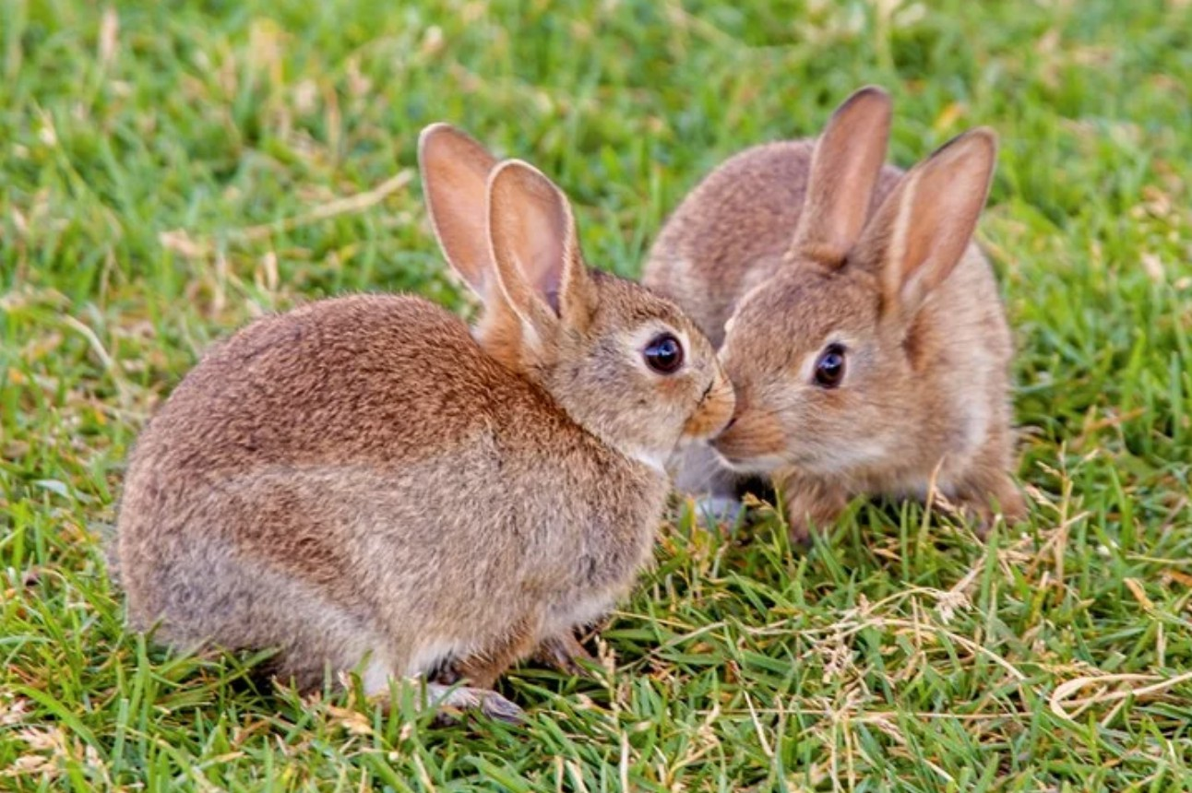
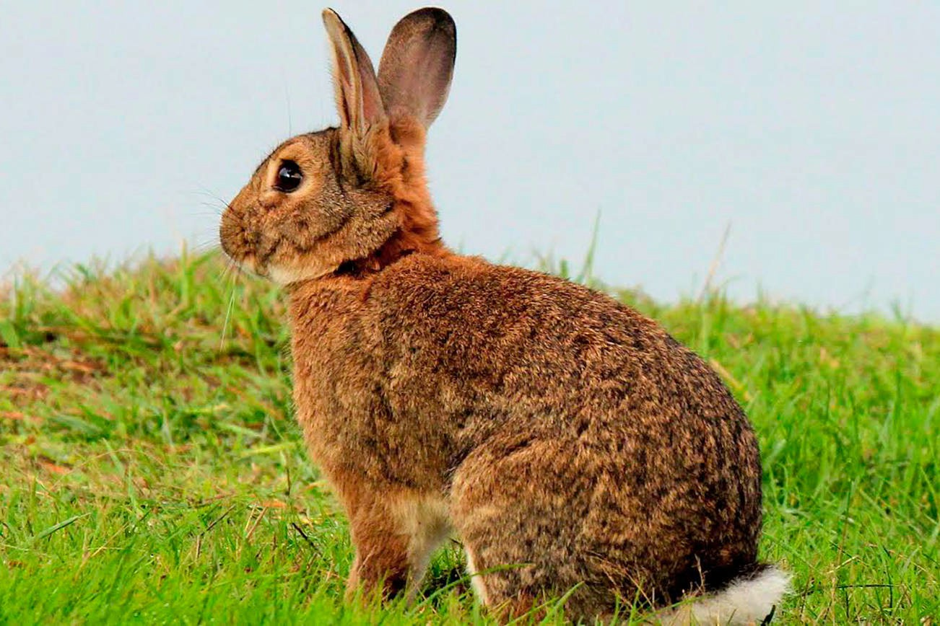
Are they the same kind of animal?
For the same reason, the model has never seen a rabbit during training.
So, it does not know the two images are rabbits.
But the model knows the similarity and difference between things.
The model knows that the content of the two images are very alike.
So, the model can tell they are the same object.

Slide 15
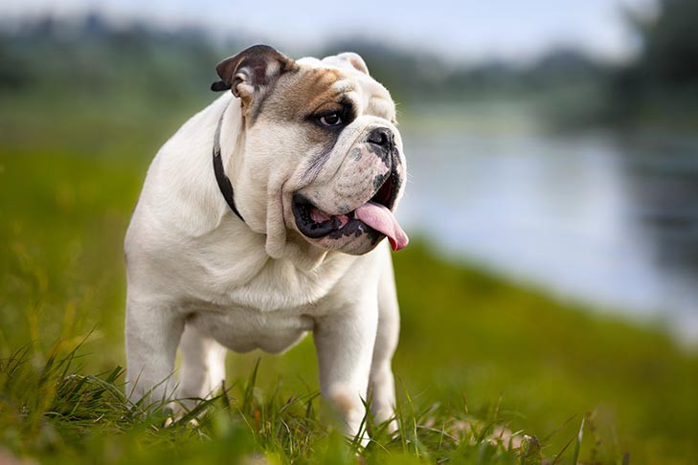
Are they the same kind of animal?
Then I show the two images to the model.
While the model has never seen a pangolin and a bulldog, the model knows the two animals look quite different.
The model believes they are different objects.
Now I ask a different question.

Slide 16
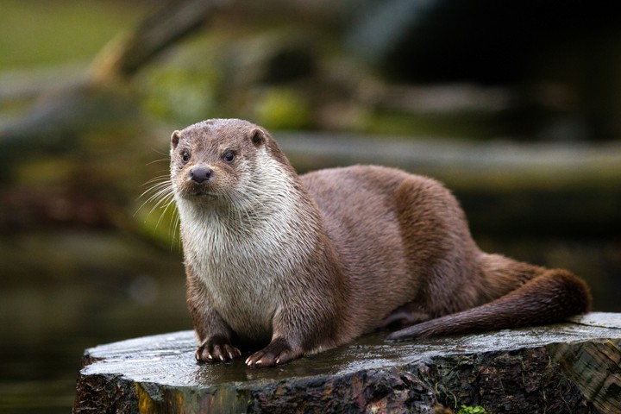
Few-Shot Learning
Query:
I have a query image. I show it to the model and ask what it is.
The model is unable to answer my question.
The model has never seen this kind of object during training.
Then I provide the model with additional information.
I show additional six images to the model.

Slide 17
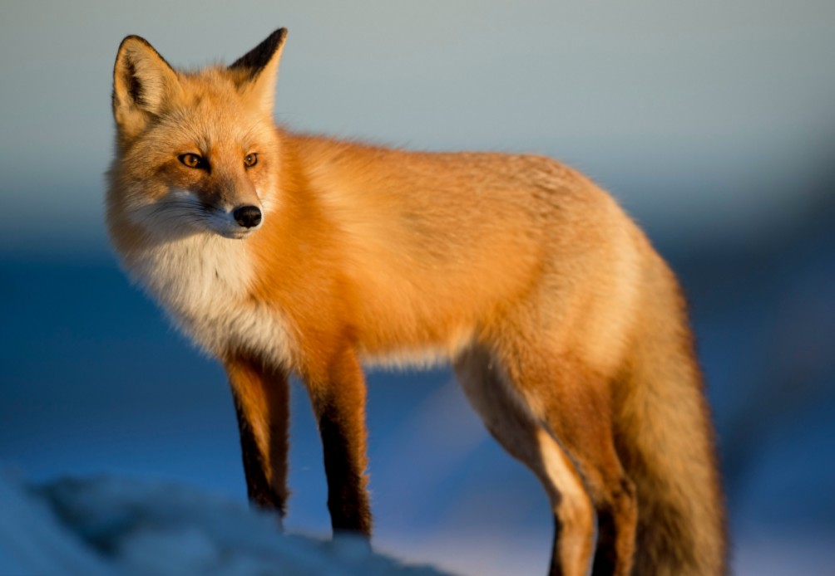
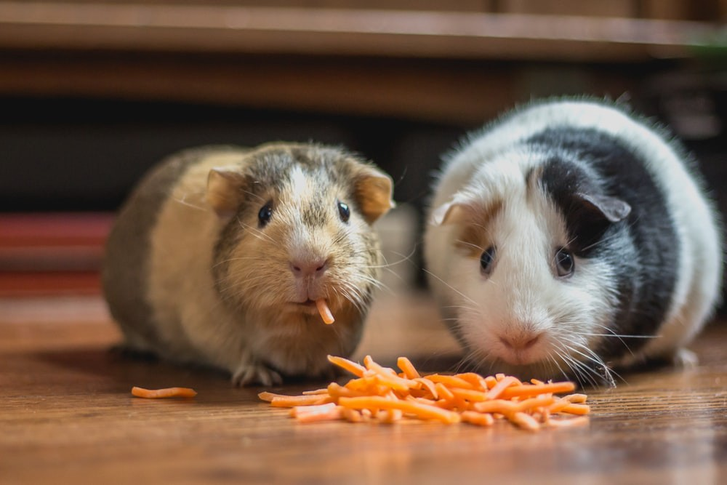
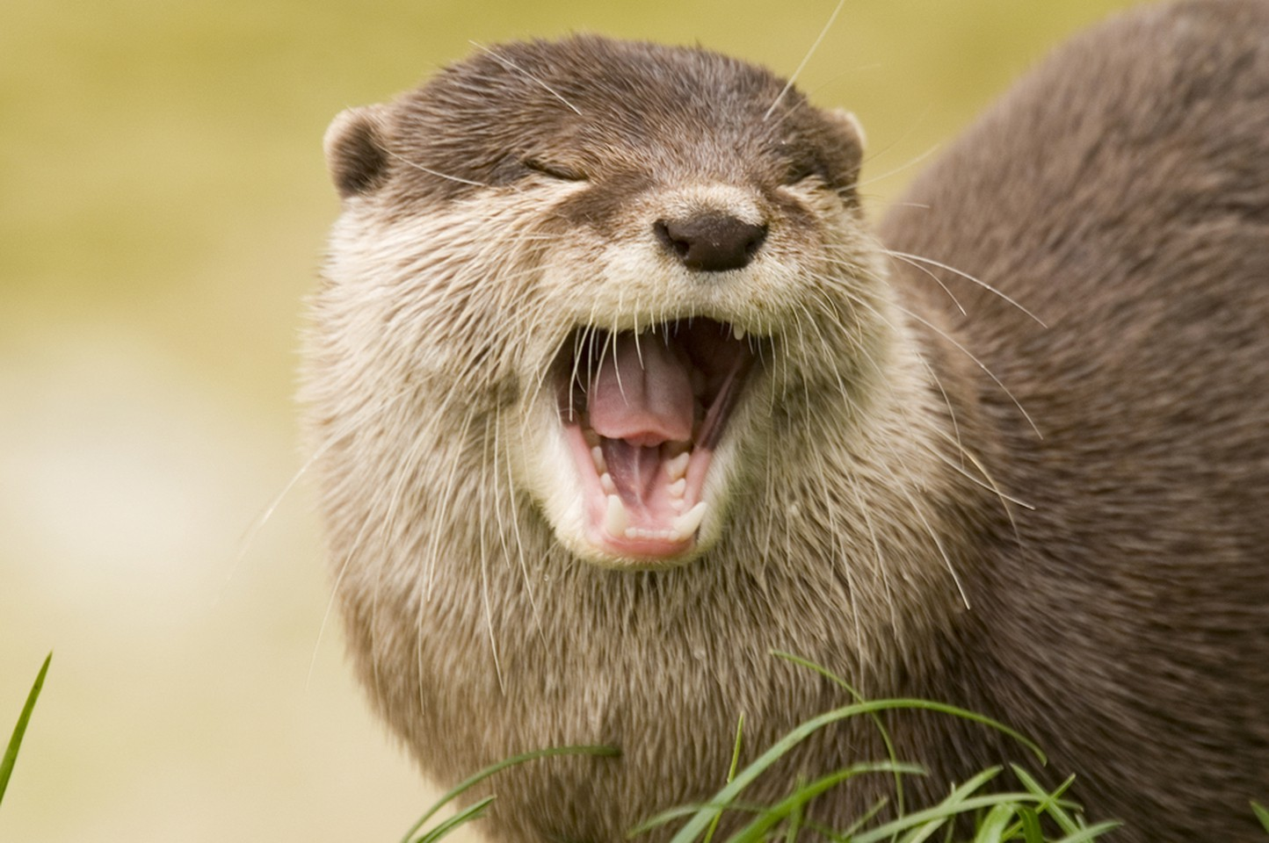
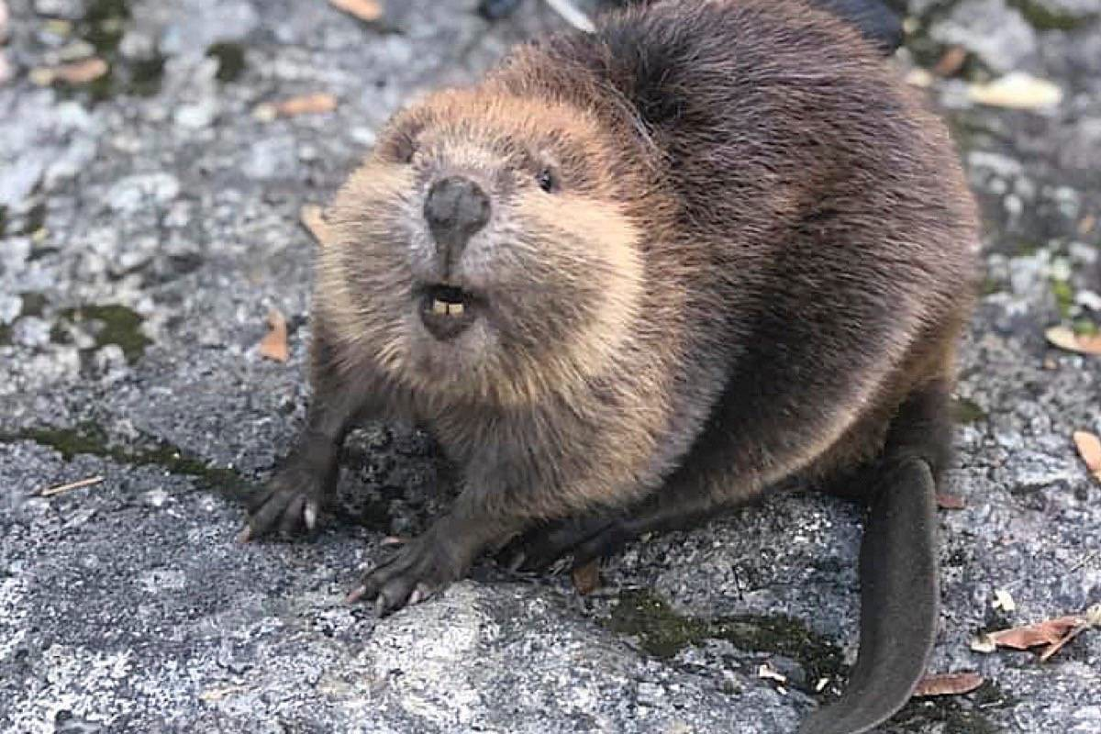
Few-Shot Learning
Query:
Support Set:
Fox Squirrel
Rabbit
Hamster
Otter
Beaver
I tell the model that they are fox, squirrel, rabbit, hamster, otter, and beaver. Now the model can answer my question.
The model compares the query image with each of the six images. The model finds a query most similar to the otter image. So, the model believes the query is otter. Support set is better learning jargon.

Slide 18
Difference between training set and support set
Notice the difference between training set and support set.
The training set is big. Every class in the training set has many samples.
The training set is big enough for learning a deep neural network.
In contrast, the support set is small.
Every class has at most a few samples.
In this example, every class has only one sample.
It is impossible to train a deep neural network using such a small set of data.

Slide 19
Difference between training set and support set
Aspect | Training Set | Support Set
Size | Large | Small
Number of Samples | Each class has many samples | Each class has a limited number of samples
Purpose | Suitable for training deep neural networks | Used for few-shot or one-shot learning
Data Distribution | Classes are well represented | Classes have at most a few samples
Learning Approach | Enables the model to generalize over unseen data | Forces the model to differentiate using few examples

Slide 20
Basic idea of few shot learning.
We train a big model using a big training set.
Rather than training the model to recognize a specific object such as tiger and elephant
in the training set, we train the model to know the similarity and difference between objects.
With the additional information provided by the support set, the model can tell the query image is otter, although otter is not among the classes in the training set.
Let's explain what few shot learning and meta-learning are

Slide 21
Few-Shot Learning and Meta Learning

Slide 22
Meta Learning
Few-shot learning is a kind of meta learning.
Meta learning: learn to learn.
Traditional supervised learning asks the model to recognize the training data and then
generalize to unseen test data. Differently, meta-learning's goal is learn-to-learn
Reference:
Fei-Fei, Fergus, & Perona. One-shot learning of object categories. IEEE Transactions on PAMI, 2006.

Slide 23
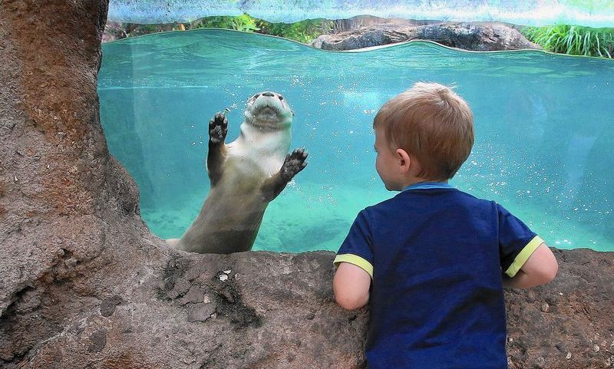
Meta Learning
What’s this?
You bring your kid to the zoo.
He is excited to see the fluffy animal in the water, which he has never seen before.
He asks you, Daddy, what's this?
Although he has never seen this animal before, he is a smart kid and can learn by himself.

Slide 24
Meta Learning
What’s this?
Now, you give the kid a set of cards. On every card, there is an animal and its name.
Fox
Squirrel
Rabbit
Hamster
Otter
Beaver
Give him the cards:

Slide 25
Meta Learning
The kid has never seen the animal in the water.
He has never seen the animals on the card either.
But the kid is so smart that by taking a look at all the cards, he knows the animal in the
water is an otter.
The animal in the water is most similar to the otter on the card.
Teaching the kid to learn by himself is called meta-learning.
He learns to recognize otter using only one card. This is called one-shot learning
Query:
Fox
Squirrel
Rabbit
Hamster
Otter
Beaver
Support set:

Slide 26
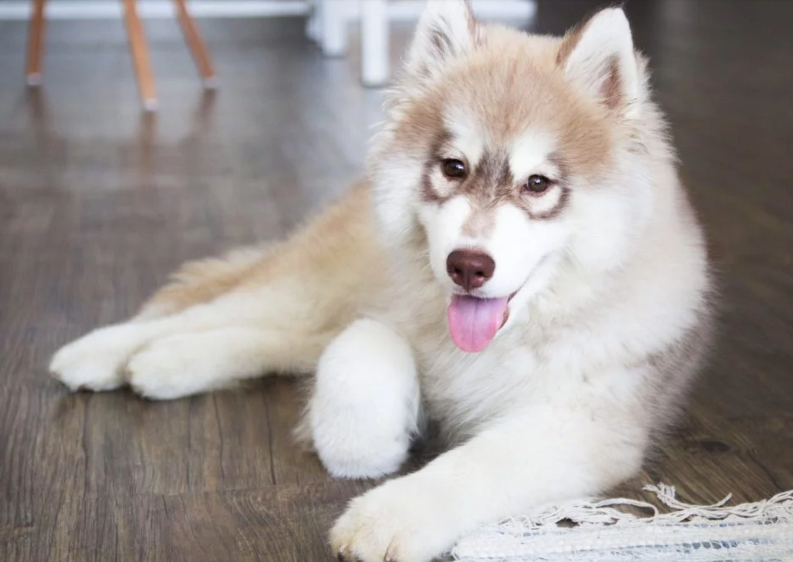
Supervised Learning vs. Few-Shot Learning
Traditional supervised learning:
Test samples are never seen before.
Test samples are from known classes.
Husky
⋮
Training Set
Test Sample
Elephant
Tiger
Macaw
Car
⋮
⋮
⋮
⋮

Slide 27
Supervised Learning vs. Few-Shot Learning
Few-shot learning:
Query samples are never seen before.
Query samples are from unknown classes.
Training Set
Query Sample
Husky
Elephant
Tiger
Macaw
Car
⋮
⋮
⋮
⋮
⋮

Slide 28
Training Set, Support Set, and Query
Rabbit
Fox Squirrel
Hamster Otter
Beaver
Support Set:
Training Set
Query Sample
Husky
Elephant
Tiger
Macaw
Car
⋮
⋮
⋮
⋮
⋮

Slide 29
k-way n-shot Support Set
Fox Squirrel Rabbit Hamster
Otter
Beaver
Support Set:
𝑘-way: the support set has 𝑘 classes.
𝑛-shot: every class has 𝑛 samples.

Slide 30
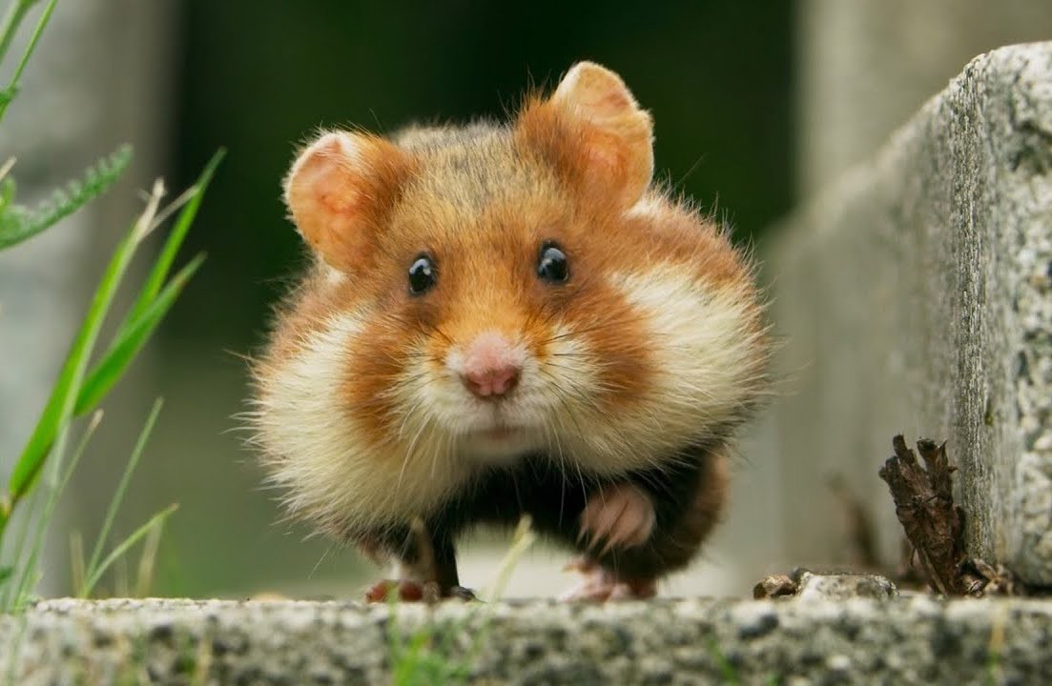
k-way n-shot Support Set
Support Set:
Squirrel
Rabbit
Hamster
Otter
2-shot
4-way

Slide 31
Prediction Accuracy
Accuracy
# of ways
(# of classes)
When performing few-shot learning, the prediction accuracy depends on the number of ways and the number of shots.
In the figure, the x-axis is the number of ways, that is, the number of classes in the support set.
The y-axis is the prediction accuracy. As the number of ways increases, the prediction accuracy drops.
Why does this happen?

Slide 32
Squirrel
Rabbit
Otter
This is 3-way one-shot learning
3-way is easier than 6-way
Choosing one out of three is easier than choosing one out of six.
Fox
Squirrel
Rabbit
Hamster
Otter
Beaver

Slide 33
Prediction Accuracy
Accuracy
# of shots
In this figure, the x-axis is the number of shots, that is, the number of samples per class.
The y-axis is the prediction accuracy. As the number of shots increases, the prediction accuracy improves.

Slide 34
Squirrel
Rabbit
Hamster
Otter
2-shot is easier than 1-shot
Squirrel Rabbit Hamster Otter

Slide 35
Idea: Learn a Similarity Function

Slide 36
Basic Idea
Learn a similarity function: sim(𝐱, 𝐱*).

Slide 37
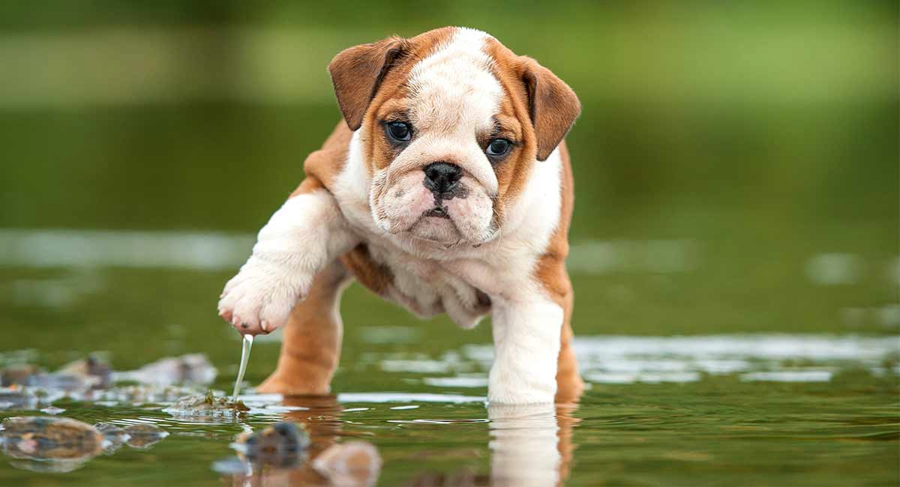
Basic Idea
Learn a similarity function: sim(𝐱, 𝐱*).
Ideally, sim 𝐱,, 𝐱₋ = 1, sim 𝐱,, 𝐱₀
= 0, and sim 𝐱₋, 𝐱₀ = 0.
Bulldog
Bulldog
Fox
𝐱,
𝐱₋
𝐱₀

Slide 38
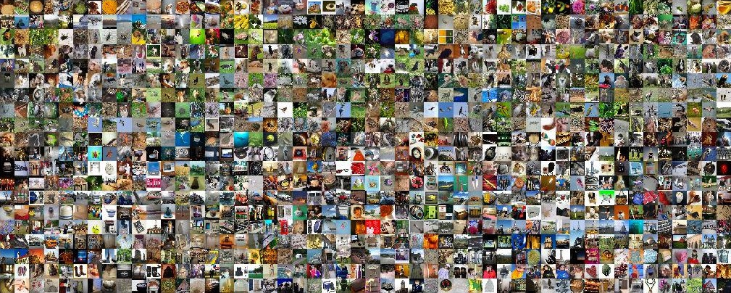
Basic Idea
First, learn a similarity function from large-scale training dataset.

Slide 39
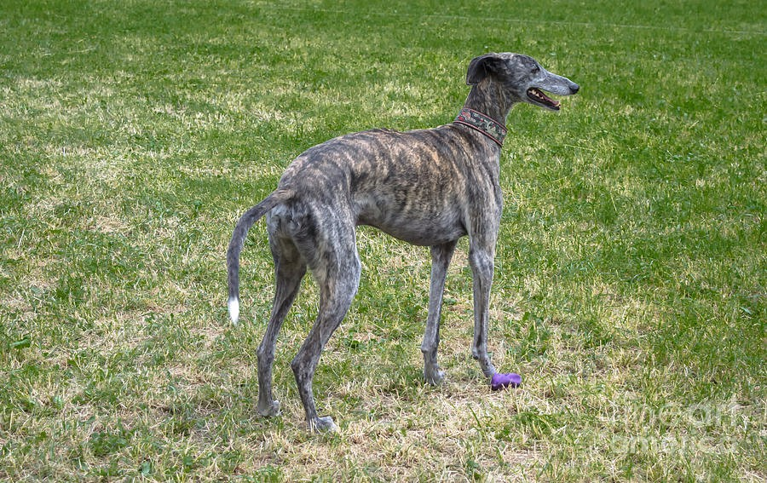
Basic Idea
First, learn a similarity function from large-scale training dataset.
Then, apply the similarity function for prediction.
Compare the query with every sample in the support set.
Find the sample with the highest similarity score.
Support Set:
Greyhound Bulldog Armadillo Pangolin
Otter
Beaver

Slide 40
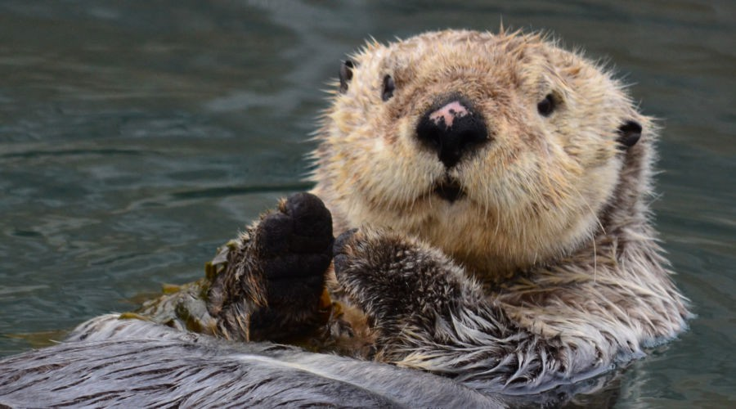
Basic Idea
What is in the image?
Query:
Support Set:
Greyhound Bulldog Armadillo Pangolin
Otter
Beaver

Slide 41
Basic Idea
What is in the image?
Query:
sim = 0.2
Greyhound
Bulldog
Armadillo
Pangolin
Otter
Beaver

Slide 42
Basic Idea
What is in the image?
Query:
sim = 0.2 |  | sim = 0.1
Greyhound |  | Bulldog | Armadillo | Pangolin | Otter | Beaver

Slide 43
Basic Idea
What is in the image?
Query:
sim = 0.2 |  | sim = 0.1 |  | sim = 0.03
Greyhound |  | Bulldog |  | Armadillo | Pangolin | Otter | Beaver

Slide 44
Basic Idea
What is in the image?
Query:
sim = 0.2 |  | sim = 0.1 |  | sim = 0.03 |  | sim = 0.05 |  | sim = 0.7 |  | sim = 0.5
Greyhound |  | Bulldog |  | Armadillo |  | Pangolin |  | Otter |  | Beaver

Slide 45
Basic Idea
What is in the image?
Query:
sim = 0.7
Otter
sim = 0.2
sim = 0.1
sim = 0.03
sim = 0.05
sim = 0.5
Greyhound
Bulldog
Armadillo
Pangolin
Beaver

Slide 46
Datasets
https://github.com/brendenlake/omniglot

Slide 47
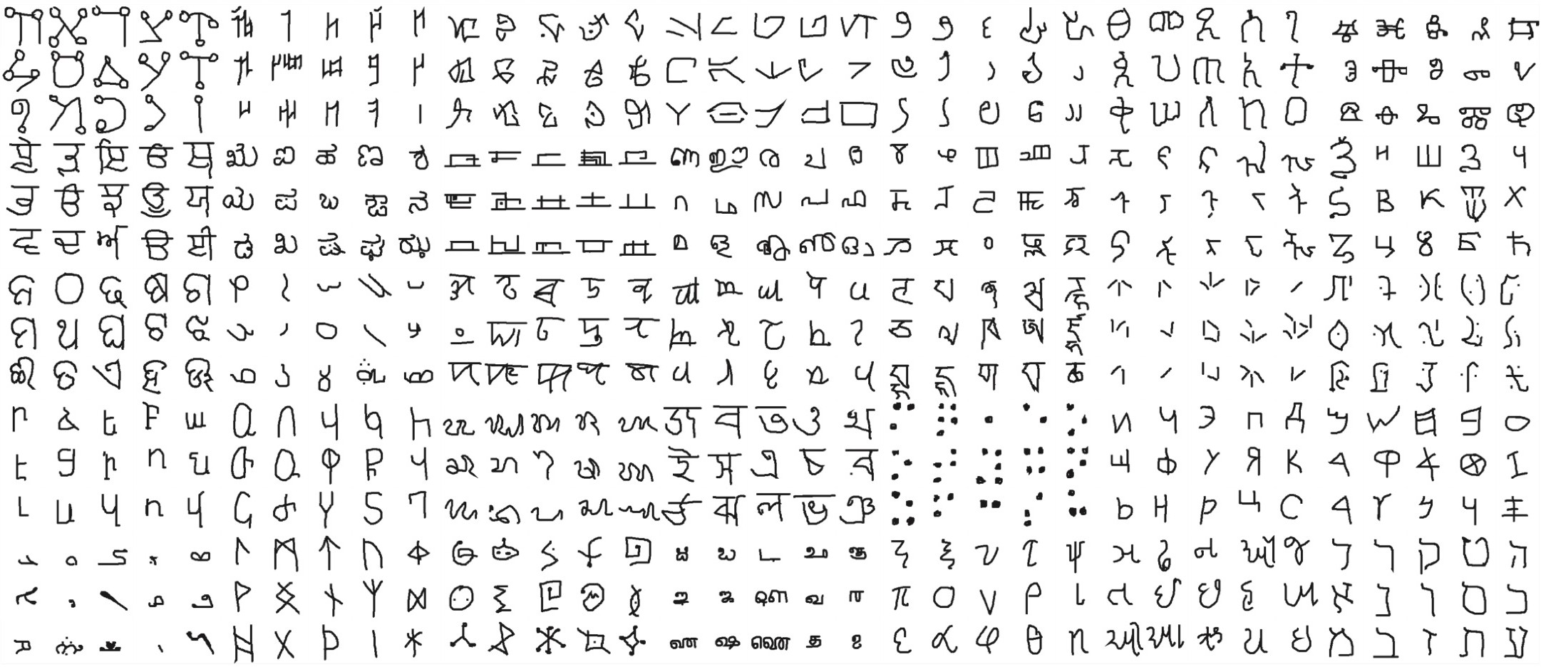
Omniglot
Official website: https://github.com/brendenlake/omniglot/
TensorFlow: https://www.tensorflow.org/datasets/catalog/omniglot

Slide 48
Omniglot
50 alphabets:
⋯
Hebrew Greek
Latin

Slide 49
Omniglot
50 alphabets:
⋯
Hebrew Greek
Latin
characters:
𝛂
𝛃
𝛄
⋯
𝛚

Slide 50




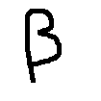






Omniglot
50 alphabets:
⋯
Hebrew Greek
Latin
characters:
𝛂
𝛃
𝛄
⋯
𝛚
samples:
⋯
⋯
⋯
⋯

Slide 51
Omniglot
50 different alphabets. (Every alphabet has many characters.)
1,623 unique characters (i.e., classes).
Each character was written by 20 different people (i.e., each class has 20 samples.)
The samples are 105×105 images.
Training set:
30 alphabets, 964 characters (classes), and 19,280 samples.
Test set:
20 alphabets, 659 characters (classes), and 13,180 samples.

Slide 52
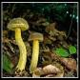
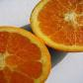
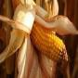
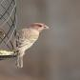
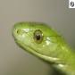
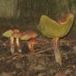














Mini-ImageNet
100 classes:
Mushroom Orange Corn
Bird
Snake
600 samples
⋯
⋯
⋯
⋯
⋯

Slide 53
Siamese Network

Slide 54
Learning Pairwise Similarity Scores
Reference:
Bromley et al. Signature verification using a Siamese time delay neural network. In NIPS. 1994.
Koch, Zemel, & Salakhutdinov. Siamese neural networks for one-shot image recognition. In ICML, 2015.

Slide 55
Training Set
Husky
Elephant
Tiger
Macaw
Car
⋮
⋮
⋮
⋮
⋮

Slide 56



Training Data
Positive Samples
Negative Samples
( , , 1)
( , , 1)
( , , 1)
( , , 0)
( , , 0)
( , , 0)

Slide 57




CNN for Feature Extraction
Conv, Pool
Conv, Pool
Flatten
𝐱
𝐟 𝐱

Slide 58
Training Siamese Network
𝐱
𝐱

Slide 59
Training Siamese Network
𝐟
𝐱
𝐟
𝐱

Slide 60
Training Siamese Network
𝐟
𝐱
𝐡 = 𝐟 𝐱
𝐟
𝐱
𝐡 = 𝐟 𝐱

Slide 61
Training Siamese Network
𝐟
𝐱
𝐡
𝐟
𝐳 = 𝐡 − 𝐡 |
𝐱
𝐡

Slide 62

Training Siamese Network
𝐟
𝐱
Dense Layers
𝐡
𝐟
𝐳
𝐱
𝐡

Slide 63

Training Siamese Network
𝐟
𝐱
Dense Layers
𝐡
Sigmoid
sim 𝐱, 𝐱)
𝐟
𝐳
𝐱
𝐡

Slide 64
Training Siamese Network
Target = 1
Loss
𝐟
𝐱
Dense Layers
𝐡
Sigmoid
sim 𝐱, 𝐱
𝐟
𝐳
𝐱
𝐡

Slide 65
Training Siamese Network
Loss
Target = 1
^{𝐱}$ 𝐡$ Sigmoid
sim 𝐱$, 𝐱%
𝐳
𝐱% 𝐡%
𝐟
Dense Layers
𝐟

Slide 66
Training Siamese Network
Loss
Target = 1
^{𝐱}$ 𝐡$ Sigmoid
sim 𝐱$, 𝐱%
𝐱% 𝐡%
𝐟
Dense Layers
𝐟
𝐳

Slide 67
Training Siamese Network
Loss
Target = 1
^{𝐱}$ 𝐡$ Sigmoid
sim 𝐱$, 𝐱%
𝐱% 𝐡%
𝐟
Dense Layers
𝐟
𝐳

Slide 68
Training Siamese Network
Target = 0
Loss
𝐟
𝐱
Dense Layers
𝐡
Sigmoid
sim 𝐱, 𝐱
𝐟
𝐳
𝐱
𝐡

Slide 69
One-Shot Prediction
6-way 1-shot prediction: support set has 6 test classes; each class has 1 sample.
The training data (for the Siamese network) does not contain the 6 classes.
Support Set:
Rabbit Hamster
Fox
Squirrel
Otter
Beaver

Slide 70

One-Shot Prediction
Query:
Support Set:
Rabbit Hamster
Fox
Squirrel
Otter
Beaver

Slide 71
One-Shot Prediction
Query:
sim = 0.2
Fox
Squirrel
Rabbit
Hamster
Otter
Beaver

Slide 72
One-Shot Prediction
Query:
sim = 0.2 |  | sim = 0.9
Fox |  | Squirrel | Rabbit | Hamster | Otter | Beaver

Slide 73
One-Shot Prediction
Query:
sim = 0.2 |  | sim = 0.9 |  | sim = 0.7 |  | sim = 0.5 |  | sim = 0.3 |  | sim = 0.4
Fox |  | Squirrel |  | Rabbit |  | Hamster |  | Otter |  | Beaver

Slide 74
One-Shot Prediction
Query:
sim = 0.9
Squirrel
sim = 0.2
sim = 0.7
sim = 0.5
sim = 0.3
sim = 0.4
Fox
Rabbit
Hamster
Otter
Beaver

Slide 75
Triplet Loss
Reference:
Schroff, Kalenichenko, & Philbin. Facenet: A unified embedding for face recognition and clustering. In
CVPR, 2015.

Slide 76

Data for Training Siamese Network
Training Set
Elephant Tiger Macaw
Car

Slide 77
Data for Training Siamese Network
Training Set
Elephant Tiger Macaw
Car
anchor

Slide 78
Data for Training Siamese Network
Training Set
Elephant Tiger Macaw
Car
A
anchor

Slide 79
Data for Training Siamese Network
Training Set
Elephant Tiger Macaw
Positive
Car

Slide 80
Data for Training Siamese Network
Training Set
Elephant Tiger Macaw
Positive
P
Car

Slide 81
Data for Training Siamese Network
Training Set
Elephant Tiger Macaw
Car
Negative

Slide 82
Data for Training Siamese Network
P
Training Set
Elephant Tiger Macaw
Car
A
Negative
N

Slide 83
Training- triplet Loss
In triplet loss, explicit labels are not directly used
Anchor(A): An image representing the reference point.
Positive(P): An image with the same label/class as the anchor.
Negative(N): An image with a different label/class.
Anchor and Positive Pair: Choose an anchor image and then select another image from the same class as the positive pair (based on identical labels).
Anchor and Negative Pair: Choose an image from a different class than the anchor as the negative pair.

Slide 84
Triplet Loss
_{𝐱}7
(positive)
_{𝐱}6
(anchor)
_{𝐱}8
(negative)

Slide 85

Triplet Loss
_{𝐱}7
(positive)
𝐟
_{𝐱}6
(anchor)
𝐟
_{𝐱}8
(negative)
𝐟

Slide 86
Triplet Loss
_{𝐱}7
(positive)
𝐟
𝐟 𝐱⁷
_{𝐱}6
(anchor)
𝐟
𝐟 𝐱⁶
_{𝐱}8
(negative)
𝐟
𝐟 𝐱⁸

Slide 87
Triplet Loss
_{𝐱}7
(positive)
𝐟
𝐟 𝐱⁷
𝑑⁷ =
𝐟 𝐱⁷
− 𝐟 𝐱⁶
_{𝐱}6
(anchor)
𝐟
𝐟 𝐱⁶
_{𝐱}8
(negative)
𝐟
𝐟 𝐱⁸

Slide 88
Triplet Loss
_{𝐱}7
(positive)
𝐟
𝐟 𝐱⁷
𝑑⁷ =
𝐟 𝐱⁷
− 𝐟 𝐱⁶
_{𝐱}6
(anchor)
𝐟
𝐟 𝐱⁶
𝑑⁸ =
𝐟 𝐱⁶
− 𝐟 𝐱⁸
8
𝐟
𝐱
𝐟 𝐱⁸
(negative)

Slide 89
Triplet Loss
_{𝐱}7
(positive)
Feature Space
_{𝐱}6
(anchor)
_{𝐱}8
(negative)
𝐟 𝐱⁶

Slide 90
Triplet Loss
_{𝐱}7
(positive)
Feature Space
_{𝐱}6
(anchor)
_{𝑑}7
𝐟 𝐱
7
_{𝐱}8
(negative)
𝐟 𝐱⁶

Slide 91
Triplet Loss
_{𝐱}7
(positive)
Feature Space
𝐟 𝐱⁸
_{𝐱}6
(anchor)
_{𝑑}8
_{𝑑}7
𝐟 𝐱
7
_{𝐱}8
(negative)
𝐟 𝐱⁶

Slide 92
Triplet Loss
_{𝐱}7
(positive)
Encourage 𝑑⁷ =
𝐟 𝐱⁷
− 𝐟 𝐱⁶
to be small.
8
6
8
Encourage 𝑑 = 𝐟 𝐱
− 𝐟 𝐱
to be big.
_{𝐱}6
(anchor)
_{𝐱}8
(negative)

Slide 93
Triplet Loss
_{𝐱}7
(positive)
Encourage 𝑑⁷ =
𝐟 𝐱⁷
− 𝐟 𝐱⁶
to be small.
Encourage 𝑑⁸ = 𝐟 𝐱⁶ − 𝐟 𝐱⁸
to be big.
If 𝑑⁸ ≥ 𝑑⁷ + 𝛼, then no loss. (𝛼 > 0 is margin.)
Otherwise, the loss is 𝑑⁷ + 𝛼 − 𝑑⁸.
𝐱
6
(anchor)
_{𝐱}8
(negative)

Slide 94
Triplet Loss
_{𝐱}7
(positive)
Encourage 𝑑⁷ =
𝐟 𝐱⁷
− 𝐟 𝐱⁶
to be small.
Encourage 𝑑⁸ = 𝐟 𝐱⁶ − 𝐟 𝐱⁸
to be big.
If 𝑑⁸ ≥ 𝑑⁷ + 𝛼, then no loss. (𝛼 > 0 is margin.)
Otherwise, the loss is 𝑑⁷ + 𝛼 − 𝑑⁸.
𝐱
6
(anchor)
Loss 𝐱⁶, 𝐱⁷, 𝐱⁸ = max 0, 𝑑⁷ + 𝛼 − 𝑑⁸ .
Update the CNN (function 𝐟) to decrease the loss.
_{𝐱}8
(negative)

Slide 95
Quadruplet loss
Components:
Anchor: The reference image that will be compared to others.
Positive: An image of the same class as the anchor.
Negative: An image of a different class from the anchor.
Second Negative: An image from a different class than both the anchor and positive, but also distinct from the first negative.
Loss Calculation:
The quadruplet loss consists of two comparisons:
The first comparison is similar to triplet loss, where the anchor-positive pair should be closer than the anchor-negative pair.
The second comparison ensures that the anchor-positive pair is closer than the positive-second negative pair.

Slide 96

Quadruplet loss

Slide 97


Slide 98
Siamese Network- Contrastive Loss
(Image 1, Image 2 ,1) positive pair
Image Data
Training Data
(Image 1, Image 2 ,1) positive pair
Input Images
Labels
(Image 1, Image 2 ,0) negative pair
(Image 1, Image 2 ,0) negative pair
(Image 1, Image 2 ,1) positive pair
Positive Pair: Two images of the same class (similar images).
Negative Pair: Two images from different classes (dissimilar images).
Typically, both images in a pair will pass through the same feature extraction network to produce consistent representations.

Slide 99

Contrastive loss
y is a binary label indicating whether the pair is similar (0) or dissimilar (1).
𝐷 represents the Euclidean distance (or some other distance metric) between the two feature vectors.
𝑚 is a margin value that defines the minimum distance between dissimilar pairs.
𝐿 is the resulting contrastive loss value.
The loss aims to minimize the distance between positive pairs and enforce a margin of separation between negative pairs.
The margin m ensures that negative pairs don't get too close, preventing the model from clustering all pairs too tightly.

Slide 100

https://gombru.github.io/2019/04/03/ranking_loss/
https://blog.fastforwardlabs.com/2021/05/26/deep-learning-for-automatic-offline-signature-verification-an-ntroduction.html

Slide 101


Slide 102
One-Shot Prediction
Query:
Support Set:
Rabbit Hamster
Fox
Squirrel
Otter
Beaver

Slide 103
One-Shot Prediction
Query:
dist = 231
Fox
Squirrel
Rabbit
Hamster
Otter
Beaver

Slide 104
One-Shot Prediction
Query:
dist = 231 |  | dist = 19
Fox |  | Squirrel | Rabbit | Hamster | Otter | Beaver

Slide 105
One-Shot Prediction
Query:
dist = 231 |  | dist = 19 |  | dist = 138 |  | dist = 76 |  | dist = 122 |  | dist = 94
Fox |  | Squirrel |  | Rabbit |  | Hamster |  | Otter |  | Beaver

Slide 106
One-Shot Prediction
Query:
dist = 19
Squirrel
dist = 231
dist = 138
dist = 76
dist = 122
dist = 94
Fox
Rabbit
Hamster
Otter
Beaver

Slide 107
Summary

Slide 108
Basic Idea of Few-Shot Learning
Train a Siamese network on large-scale training set.
Given a support set of 𝑘-way 𝑛-shot.
𝑘-way means 𝑘 classes.
𝑛-shot means every class has 𝑛 samples.
The training set does not contain the 𝑘 classes.
Given a query, predict its class.
Use the Siamese network to compute similarity or distance.

Slide 109
Siamese Network for Pairwise Similarity
Target = 1
Loss
𝐟
𝐱
Dense Layers
𝐡
Sigmoid
sim 𝐱, 𝐱
𝐟
𝐳
𝐱
𝐡

Slide 110
Siamese Network with Triplet Loss
_{𝐱}7
(positive)
𝐟
𝐟 𝐱⁷
𝑑⁷ =
𝐟 𝐱⁷
− 𝐟 𝐱⁶
_{𝐱}6
(anchor)
𝐟
𝐟 𝐱⁶
𝑑⁸ =
𝐟 𝐱⁶
− 𝐟 𝐱⁸
8
𝐟
𝐱
𝐟 𝐱⁸
(negative)

Slide 111
Pretraining and Fine Tuning
Simple but very effective method.
The basic idea is to pre-train a neural network on large-scale data and then perform fine-tuning on the small support set.
Despite its simplicity, the accuracy is comparable to the state-of-the-art

Slide 112
Preliminary

Slide 113

Cosine Similarity
1
𝐱
𝐰
−1
1
−1

Slide 114

Cosine Similarity
1
𝐱
Assume 𝐱 and 𝐰 are unit vectors:
𝐰
𝐱 = 1 and 𝐰
Cosine similarity:
cos 𝜃 = $x^{T}w$.
= 1.
𝜃
−1
1
−1

Slide 115


Cosine Similarity
1
𝐱
Assume 𝐱 and 𝐰 are unit vectors:
𝐰
𝐱 = 1 and 𝐰
Cosine similarity:
cos 𝜃 = $x^{T}w$.
= 1.
𝜃
−1
1
−1

Slide 116

Cosine Similarity
1
𝐱
𝐰
If 𝐱 and 𝐰 are not unit vectors, then their cosine similarity is:
𝜃
−1
1
−1

Slide 117


Softmax Function

Slide 118

Softmax Function
Softmax function makes the biggest entry bigger and the other entries smaller
If we use a max function, then the biggest entry is mapped to 1. And all the other entries are mapped to 0s.
Softmax makes the biggest bigger and the others smaller, which is similar to the max function.
But softmax is more gentle than max. Softmax does not make the biggest as big as 1 and the others as small as 0

Slide 119

Softmax Classifier
Here, 𝑘 is number of classes, and 𝑑 is number of features.

Slide 120
Few-Shot Prediction Using Pretrained CNN
Reference:
Dhillon, Chaudhari, Ravichandran, & Soatto. A baseline for few-shot image classification. In ICLR, 2020.
Chen, Wang, Liu, Xu, & Darrell. A New Meta-Baseline for Few-Shot Learning. arXiv, 2020.

Slide 121



Pretraining
Pretrain a CNN for feature extraction (aka embedding).
The CNN can be pretrained using standard supervised learning or Siamese network.
Conv, Pool
Conv, Pool
Flatten
𝐱
𝐟 𝐱

Slide 122



3-Way 2-Shot Support Set:
Feature Vectors:
𝐟
𝐟
𝐟
𝐟
𝐟
𝐟

Slide 123
3-Way 2-Shot Support Set:
Feature Vectors:
𝐟
mean
𝐟
𝐟
mean
𝐟
𝐟
mean
𝐟

Slide 124

3-Way 2-Shot Support Set:
Feature Vectors:
𝐟
mean
normalize
𝐟
𝐟
mean
normalize
𝐟
𝐟
mean
normalize
𝐟

Slide 125

Making Few-Shot Prediction
Query
1
𝐟
normalize
𝐪
−1
1
−1

Slide 126

Making Few-Shot Prediction
Query
1
𝛍
𝐟
1
normalize
𝐪
Normalized mean feature vectors extracted from the support set:
−1
𝛍₃
1
𝛍
2
−1

Slide 127
Making Few-Shot Prediction
Query
1
𝛍
𝐟
1
normalize
𝐪
Normalized mean feature vectors extracted from the support set:
𝛍₁
−1
𝛍₃
1
𝚳 =
𝛍₂
𝛍
2
𝛍₃
−1

Slide 128
Making Few-Shot Prediction
Make prediction:
𝐩 = Softmax 𝚳𝐪
1
𝛍₁
𝐪
−1
𝛍3
1
𝛍₂
−1

Slide 129

Making Few-Shot Prediction
1
𝛍₂
𝐪
−1
𝛍₃
1
𝛍2
Which entry of 𝐩 is the biggest?
−1

Slide 130
Fine-Tuning
Reference:
Chen, Liu, Kira, Wang, & Huang. A Closer Look at Few-shot Classification. In ICLR, 2019.
Dhillon, Chaudhari, Ravichandran, & Soatto. A baseline for few-shot image classification. In ICLR, 2020.
Chen, Wang, Liu, Xu, & Darrell. A New Meta-Baseline for Few-Shot Learning. arXiv, 2020.

Slide 131

Few-Shot Prediction Using Pretrained CNN

Slide 132
Few-Shot Prediction Using Pretrained CNN
We can fix 𝐖 = 𝚳 and 𝐛 = 𝟎. (What we have discussed.)
𝛍₂
𝚳 =
𝛍%
𝛍_{Q}

Slide 133

Fine Tuning
We can train 𝐖 and 𝐛 on the support set. (Fine tuning.)

Slide 134

Fine Tuning
We can train 𝐖 and 𝐛 on the support set. (Fine tuning.)

Slide 135

Fine Tuning
We can train 𝐖 and 𝐛 on the support set. (Fine tuning.)

Slide 136
Benefit of Fine Tuning
Fine-tuning substantially improves the prediction accuracy [1].
2% ~ 7% improvement for 5-way 1-shot.
1.5% ~ 4% improvement for 5-way 5-shot.
Similar conclusions in other papers, e.g., [2, 3].
Comparable to the sophisticated state-of-the-art methods.
Reference:
Dhillon, Chaudhari, Ravichandran, & Soatto. A baseline for few-shot image classification. In ICLR, 2020.
Chen, Liu, Kira, Wang, & Huang. A Closer Look at Few-shot Classification. In ICLR, 2019.
Chen, Wang, Liu, Xu, & Darrell. A New Meta-Baseline for Few-Shot Learning. arXiv, 2020.

Slide 137
Trick 1: A Good Initialization
Prediction made by Softmax classifier:
𝐩 = Softmax 𝐖 ⋅ 𝐟 𝐱 + 𝐛 .
A good initialization: 𝐖 = 𝚳 and 𝐛 = 𝟎 [1].
𝛍₂
𝚳 =
𝛍%
𝛍_{Q}
Reference:
1. Dhillon, Chaudhari, Ravichandran, & Soatto. A baseline for few-shot image classification. In ICLR, 2020.

Slide 138

Trick 2: Entropy Regularization
Entropy regularization is a good option [1].
Let 𝐱 be a query sample.
𝐩 = Softmax 𝐖 ⋅ 𝐟 𝐱 + 𝐛 is the prediction.
Entropy: ℍ 𝐩 = $−\sum_{k}{p_{k}log⁡(p_{k})}$
Entropy regularization: mean of ℍ 𝐩 , for all query samples.
Encourage the entropy regularization to be small. (Why?)
Typically, there are multiple queries. Each query has such an entropy. We can take the average of all the entropies.
The average is the entropy regularization. We wish to make the entropy small.
Reference:
1. Dhillon, Chaudhari, Ravichandran, & Soatto. A baseline for few-shot image classification. In ICLR, 2020.

Slide 139

Trick 2: Entropy Regularization
High Entropy
Low Entropy
High Entropy (Left Plot): When all outcomes have nearly equal probabilities, there's greater uncertainty about which outcome will occur, leading to higher entropy.
Low Entropy (Right Plot): When one outcome is much more probable than others, the system is more predictable, resulting in lower entropy.
What we hope to get.

Slide 140
Trick 3: Cosine Similarity + Softmax Classifier
Standard Softmax classifier:
𝐩 = Softmax 𝐖 𝐪 + 𝐛

Slide 141

Trick 3: Cosine Similarity + Softmax Classifier
Standard Softmax classifier:

Slide 142

Trick 3: Cosine Similarity + Softmax Classifier

Slide 143

Trick 3: Cosine Similarity + Softmax Classifier

Slide 144
Summary

Slide 145
Few-Shot Prediction by Pretrained CNN
Step 1: Pretraining
Pretrain a CNN on large-scale training data.
Use the CNN for feature extraction.
Step 2: Few-Shot Prediction
Map images in the support set to feature vectors.
Obtain the mean feature vector of each class: 𝛍₂, ⋯ , 𝛍₅ .
Compare the feature of query with 𝛍₂, ⋯ , 𝛍₅ .

Slide 146
Few-Shot Prediction by Pretrained CNN
Step 1: Pretraining
Pretrain a CNN on large-scale training data.
Use the CNN for feature extraction.
Step 2: Few-Shot Prediction
Map images in the support set to feature vectors.
Obtain the mean feature vector of each class: 𝛍₂, ⋯ , 𝛍₅ .
Compare the feature of query with 𝛍₂, ⋯ , 𝛍₅ .

Slide 147
Few-Shot Prediction by Pretrained CNN
Step 1: Pretraining
Pretrain a CNN on large-scale training data.
Use the CNN for feature extraction.
Step 2: Few-Shot Prediction
Map images in the support set to feature vectors.
Obtain the mean feature vector of each class: 𝛍₂, ⋯ , 𝛍₅ .
Compare the feature of query with 𝛍₂, ⋯ , 𝛍₅ .

Slide 148
Few-Shot Prediction by Pretrained CNN
Step 1: Pretraining
Step 2: Few-Shot Prediction

Slide 149
Fine Tuning
Step 1: Pretraining
Step 2: Fine Tuning
Training a classifier on the support set.
Tricks:
Using 𝐌 to initialize 𝐖.
Entropy regularization.
Cosine similarity + Softmax classifier.
Step 3: Few-Shot Prediction

Slide 150
Thank you!

